Slide 1
Surge Technical Capabilities Camunda
Getting from 0 to 100 with process automation
1

Slide 2

DRIVING AGILITY IN TELECOMMUNICATIONS
Use Cases:
Order and Provisioning Management
Install, Un-install, Upgrade Device software
^{Vendor Management} Onboarding, Contract life cycle
^{Invoice Processing -} ^{Payment Management}
Cost Allocation & Dispute Management
Notes:
Order & Provisioning Management:
Order request and approval
Order placement and order management
Order fulfilment
Order inputs
Inventory inputs (catalogue creation and maintenance)
Invoice Processing & Payment Management
Vendor invoice collection and uploading
Vendor Management
Vendor onboarding
Manage vendor and partner contract life cycle
Wireless plan optimisation
Circuit service optimisation
Cost Allocation & Dispute Management
Budget Allocation and reports
Cost recovery and financial charge back allocation

Slide 3
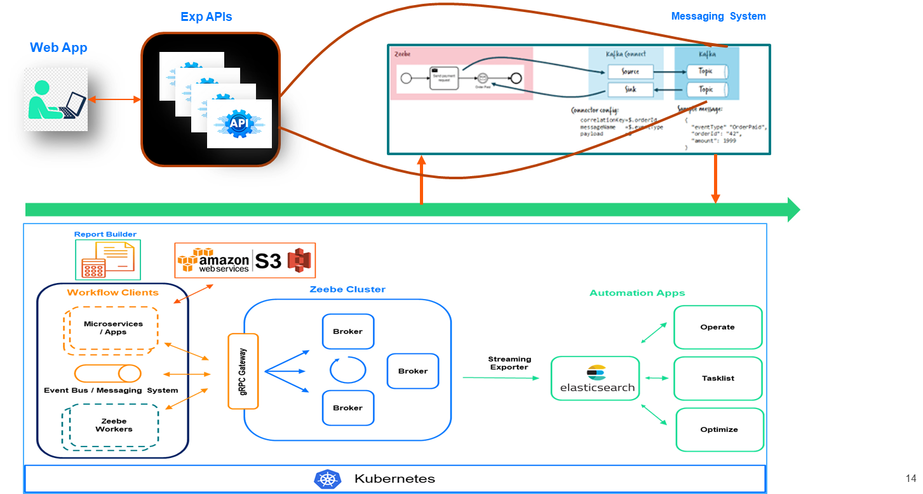
Solution Architecture
Challenges
Made our customer to design, automate, manage and improve a virtually unlimited variety of end-to-end business processes customer onboarding, device installation, technical support orchestration and more
Our solution provides organizations with speed, scale, security and resiliency without the overhead of building and maintaining infrastructure
Our approach unlocks universal connectivity via custom connectors along with simple and intuitive integrations across a variety of technology enablers.

Slide 4
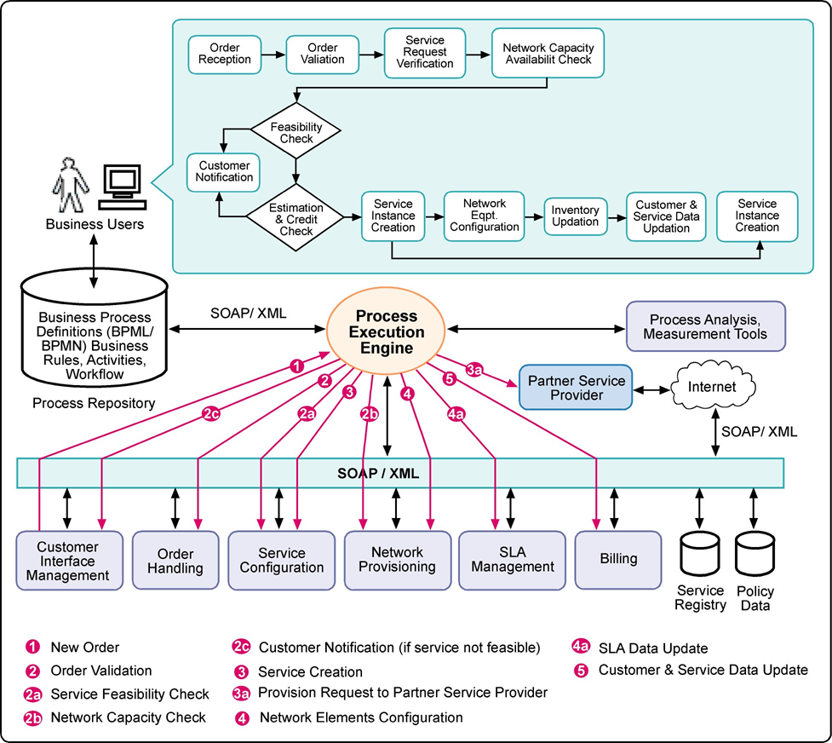
Order and provisioning management
Benefits
Visualize complex logic in one place
Easily align human and automated tasks
Use the same language for business and development, along with native Java support
Easily embed the lightweight Camunda engine in various microservices
Visualize real-time operations with Camunda Operate, seeing at-a-glance the progress of any process
Enable compliance-by-default across global distributed teams, multiple vendors and sensitive data

Slide 5

Leading Construction Equipment Manufacturer
Use Cases:
^{Consignment Delivery Tracking}
^{Defect Resolution Management}
Centralized Report Generation Platform
Machine maintenance & repair tracking
Notes:
Consignment Delivery Tracking
Keep track of consignments in transit as well as your field staff fulfilling deliveries in real-time
Ensure compliance during pick-up and delivery with photographic proof and electronic signature with automated alerts and notifications
Flexibly align operating procedures with your standards and protocols for goods transportation
Coordinate field and back office teams effortlessly to help them provide consistent delivery experiences with the ability to track pit stops and trip incentives
Collaborate with customers and provide them with real-time updates on consignment delivery
Defect Resolution Management
Obtain a bird’s eye view of all defects and ongoing complaints
Define custom procedural workflow in handling various types of complaints and ensure compliance
Enhance accountability and make sure remediations or corrective actions are followed through in detail with proof of corrective actions taken
Identify defects and provide references of defects with photographs and maintain a centralised system of investigation notes
Live-track field teams while they conduct investigations at customer locations
Machine maintenance & repair tracking
Manage preventive maintenance of machines by scheduling and monitoring periodic maintenance activities across facilities in real-time
Ensure compliance with organisational maintenance standards by adhering to SOPs with detailed checklists and photographic proof of completion
Track and manage breakdown workflows for immediate resolution and subsequently drive root cause analysis, resulting in improved preventive maintenance
Improve accountability with centralised governance of maintenance activities at all levels i.e. local, regional, and corporate
Live-track roaming engineers providing specialist maintenance and repair services across multiple facilities and locations

Slide 6
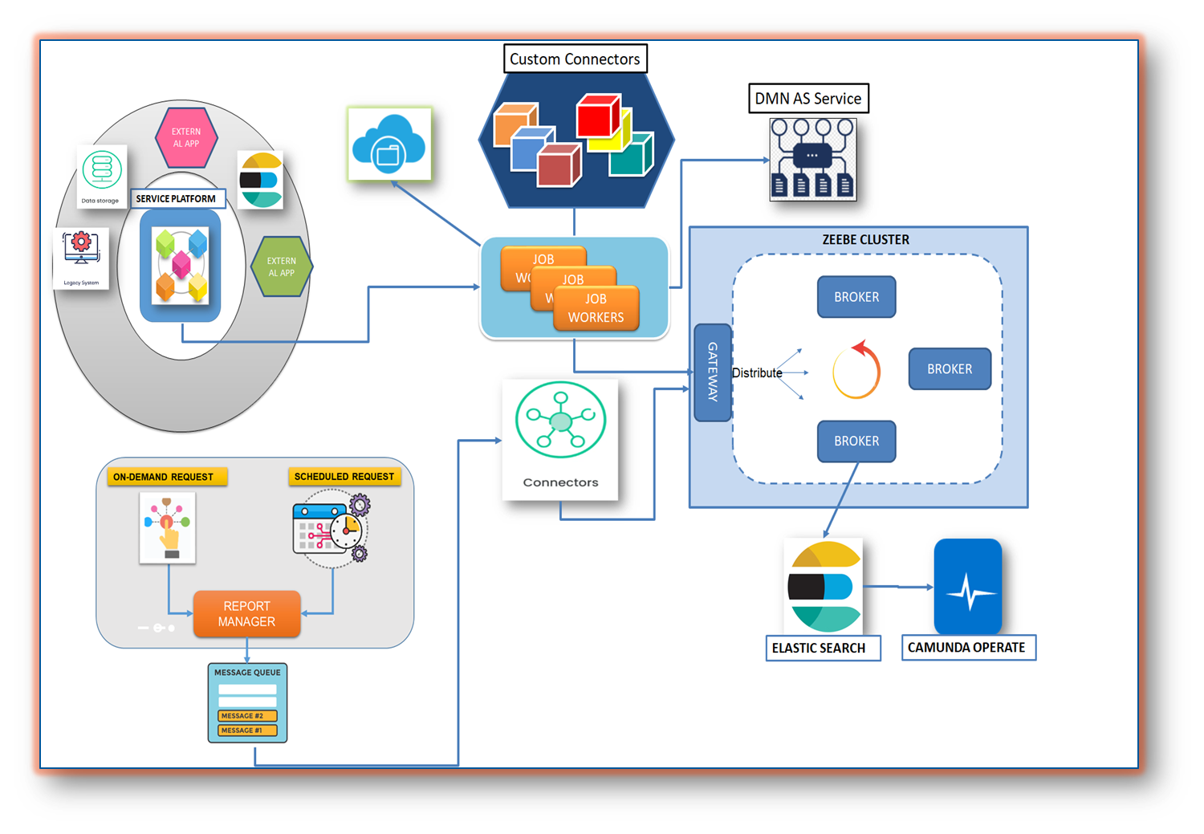
Solution Architecture
Challenges
Gather Data from Multiple applications
Complex custom logic to process the data
Configurable RULE engine to bring more agility into in the workflow system
Business and IT teams struggle to communicate and collaborate to publish new Reports.

Slide 7
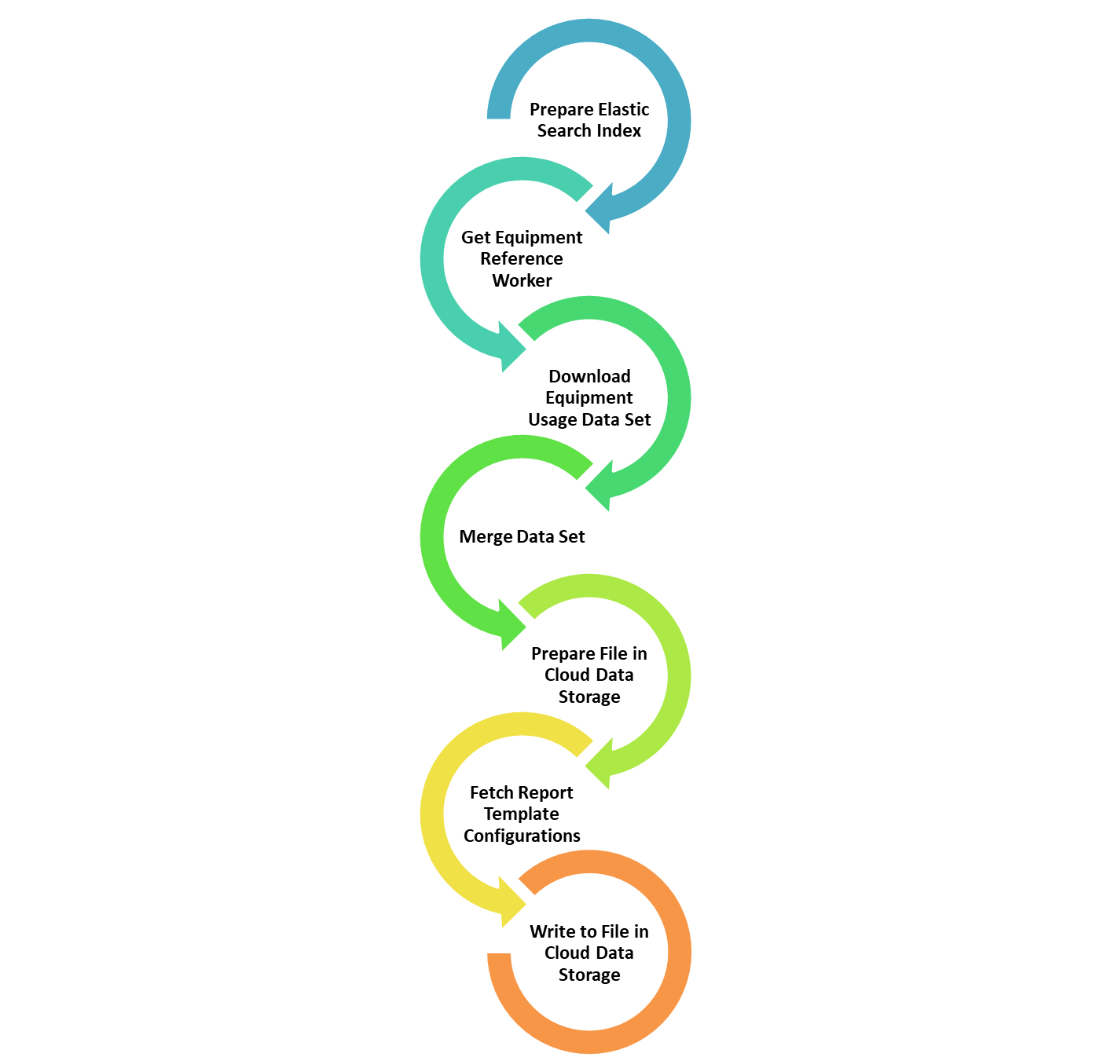
Equipment Management Report
Benefits
40% of logic has been moved as reusable components (Connectors) which can be used across the reports & developers has the flexibility to drag & drop the connectors while designing the process
Data Set download
Data Merging Component
Report generation based on template
Data upload to storage
10% of the static business key attributes are moved into configurable business rules (DMN) & Business users has the flexibility to update the business rules
Template configurations
Service end points
Request attributes to download the data via endpoints
Attributes for report sections
60% of Total effort has been reduced in development effort

Slide 8

Financial & Wealth Management
Use Cases:
Process Orchestration made easy to gather data from multiple applications
Re-Usable Components via Custom Connectors reduced 60% development time
Rule Engine (DMN) As a Service help the business to configure the Report and Report Attributes
Service Orchestration has helped to generate the huge volumes of Report Data in quick turn around time (< 1 min)

Slide 9
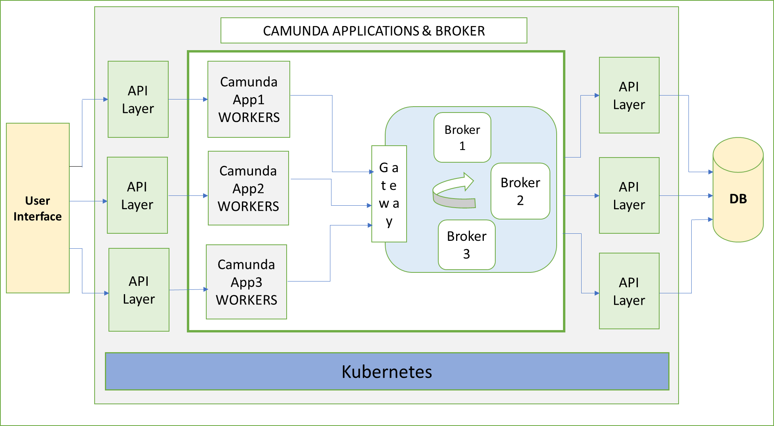
Solution Architecture
Headless approach
Re-Usable Components via Custom Connectors reduced 60% development time
Rule Engine (DMN) As a Service help the business to configure the Report and Report Attributes
Service Orchestration has helped to generate the huge volumes of Report Data in quick turn around time (< 1 min)

Slide 10
Financial & Wealth Management
Advantages:
Process Orchestration made easy to gather data from multiple applications
Re-Usable Components via Custom Connectors reduced 60% development time
Rule Engine (DMN) As a Service help the business to configure the Report and Report Attributes
Service Orchestration has helped to generate the huge volumes of Report Data in quick turn around time (< 1 min)

Slide 11

Leading Global Investment Banking
Use Cases:
Process Orchestration made easy to gather data from multiple applications
Re-Usable Components via Custom Connectors reduced 60% development time
Rule Engine (DMN) As a Service help the business to configure the Report and Report Attributes
Service Orchestration has helped to generate the huge volumes of Report Data in quick turn around time (< 1 min)

Slide 12
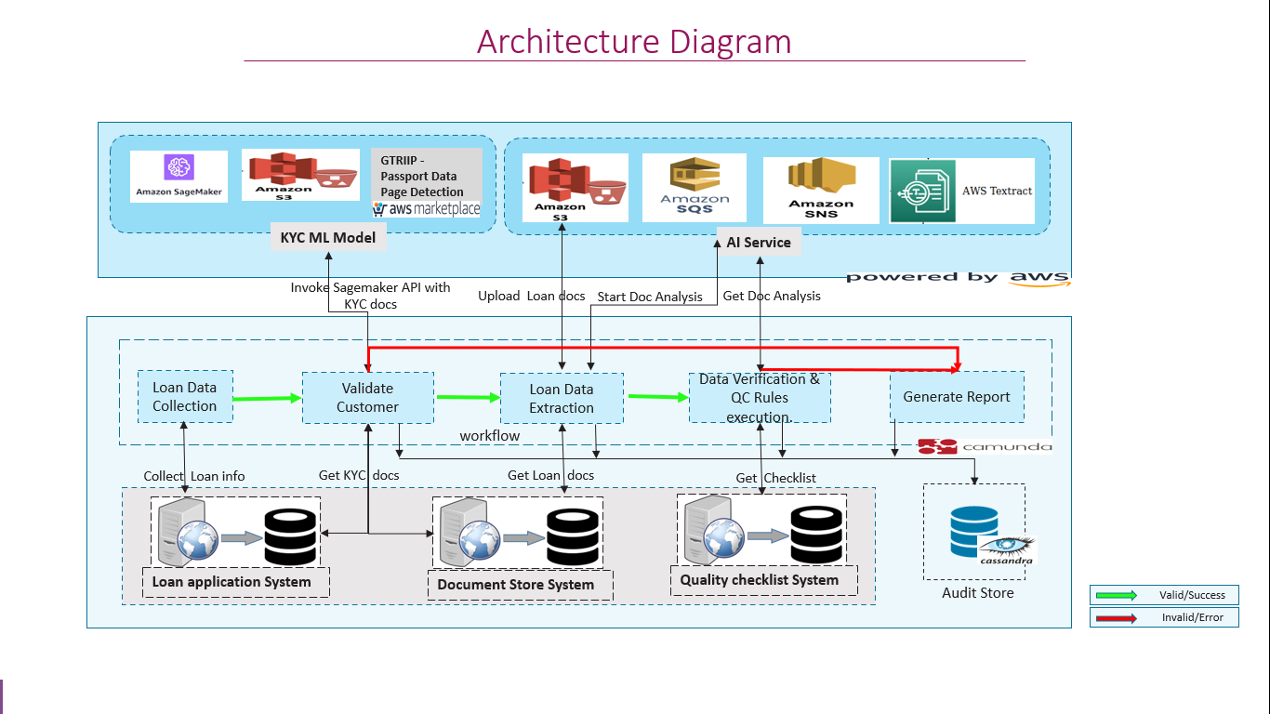
Solution Architecture – Loan Processing
Challenges
Process Orchestration made easy to gather data from multiple applications
Re-Usable Components via Custom Connectors reduced 60% development time
Rule Engine (DMN) As a Service help the business to configure the Report and Report Attributes
Service Orchestration has helped to generate the huge volumes of Report Data in quick turn around time (< 1 min)

Slide 13


Slide 14

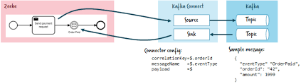

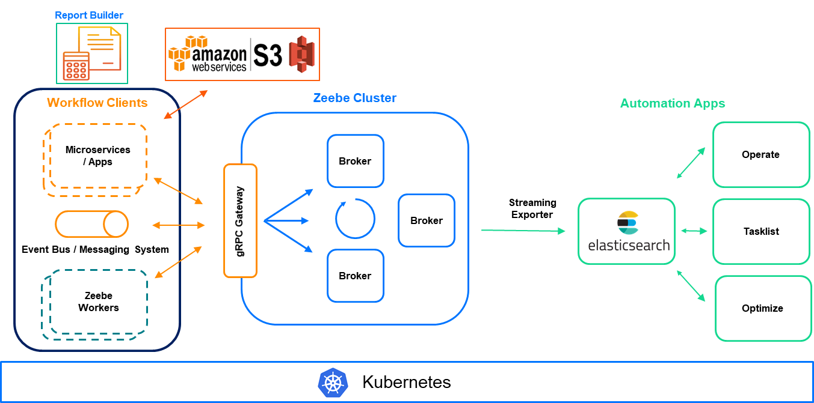
Exp APIs
Messaging System
Web App

Slide 15




Report Builder
Workflow Clients
Zeebe Cluster
Automation Apps
Microservices / Apps
Operate
Broker
Broker
Broker
Streaming Exporter
gRPC Gateway
Broker
Tasklist
gRPC Gateway
Event Bus / Messaging System
Broker
Broker
Zeebe Workers
Optimize
Zeebe Workers
Kubernetes

Slide 16
Report Bulder
Workflow Clients
Zeebe Cluster
Automation Apps
Microservices / Apps
Operate
Broker
Broker
Broker
Streaming Exporter
gRPC Gateway
Broker
Tasklist
gRPC Gateway
Event Bus / Messaging System
Broker
Broker
Zeebe Workers
Optimize
Zeebe Workers
DB
Kubernetes

Slide 18
